Slide 1
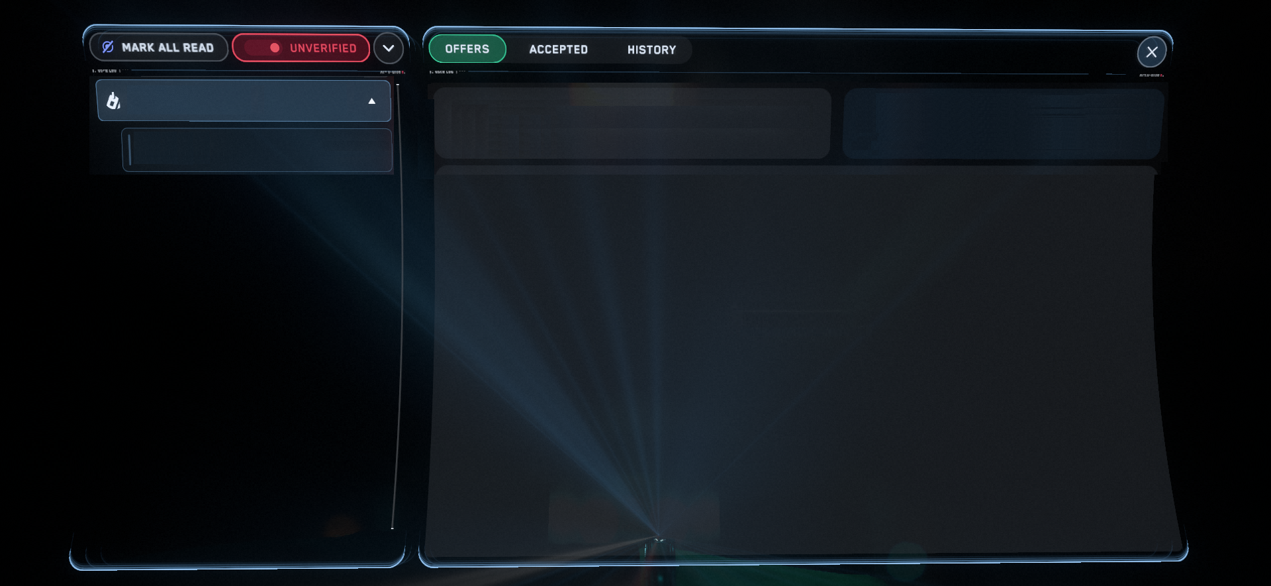
MERCENARY
Disable Outlaw Stronghold at Asteroid Base
Hangar
Reward
33,750
Contract Availability
N/A
EASY PICKINGS
36k
Contracted By
Citizens For Prosperity
BIT ZEROS
DETAILS
Following. Citizens for Prosperity. This is a Job Description so please describe your job.
And if you don‘t describe it. Then don‘t.

Slide 2
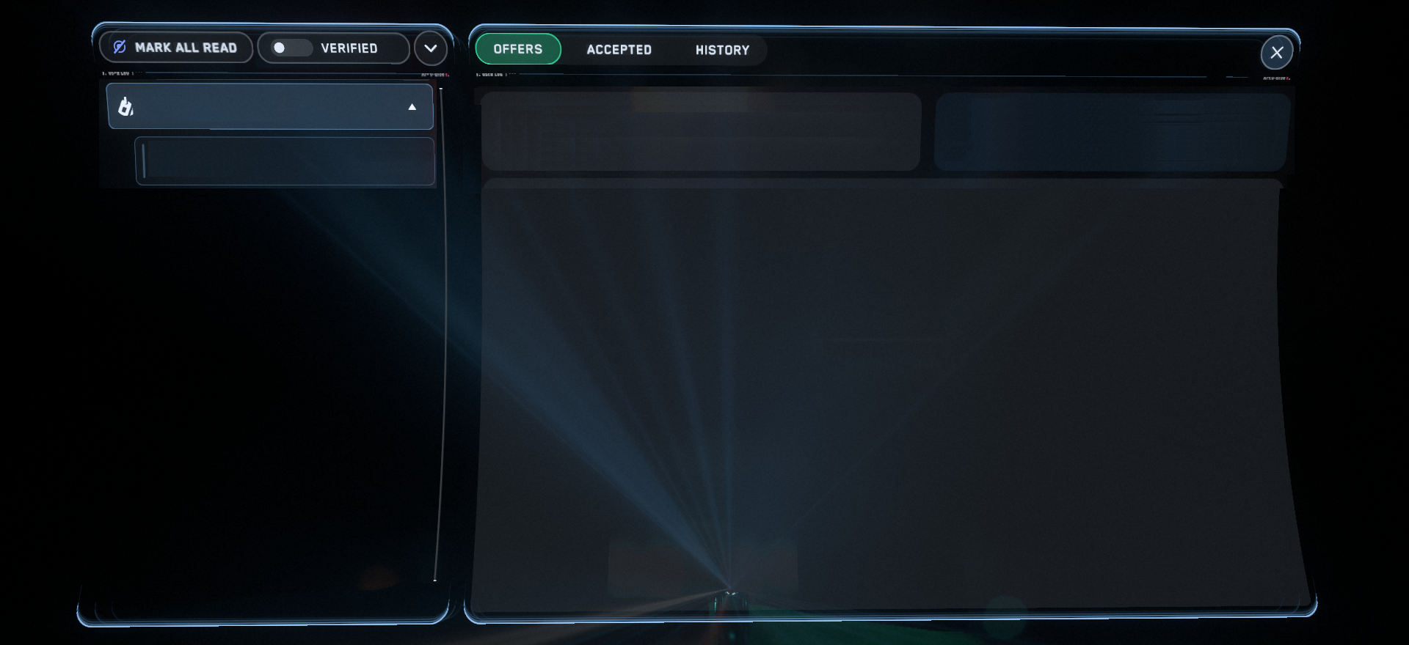
MERCENARY
Disable Outlaw Stronghold at Asteroid Base
Hangar
Reward
33,750
Contract Availability
N/A
EASY PICKINGS
36k
Contracted By
Citizens For Prosperity
BIT ZEROS
DETAILS
Following. Citizens for Prosperity. This is a Job Description so please describe your job.
And if you don‘t describe it. Then don‘t.

